Slide 1
Pansharpening
Brovey Transform & Principle Component Analysis (PCA)
Karim Abdallah, Joseph Massaro

Slide 2
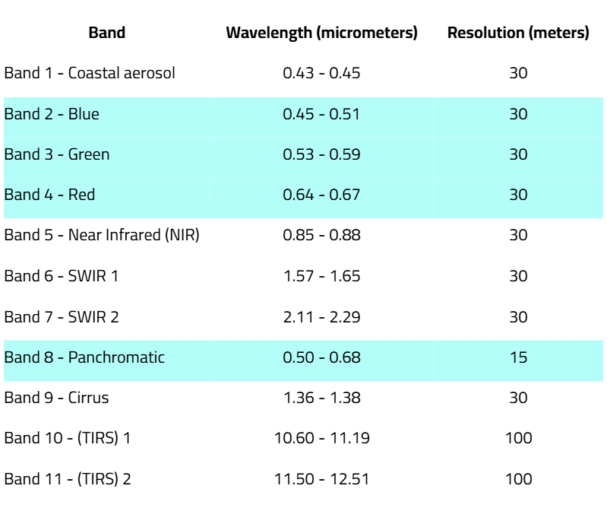
Pansharpening - Review
Pansharpening combines high-resolution panchromatic (PAN) images with lower-resolution multispectral (MS) images to produce a single high-resolution color image.
Why is it Important?
Improved Spatial Resolution: Enhances image clarity for better analysis and interpretation.
Enhanced Decision-Making: Supports environmental monitoring, land classification, and urban planning.
Cost-Effective: Utilizes existing satellite data to achieve high-resolution imagery.
Applications: Disaster response, agriculture (crop health, irrigation), etc.
Landsat 9 – PAN (15m) & MS (30m)

Slide 3
Brovey Pansharpening
Enhances the spatial resolution of multispectral images by integrating a higher-resolution panchromatic image.
Assumption: Spectral range of the panchromatic image matches the multispectral bands.
Method:
Adjusts each resampled multispectral pixel intensity.
Uses the ratio of the panchromatic pixel intensity to the sum of the multispectral band intensities.
Outcome: Enhanced multispectral image with improved spatial resolution while retaining the spectral information.

Slide 4
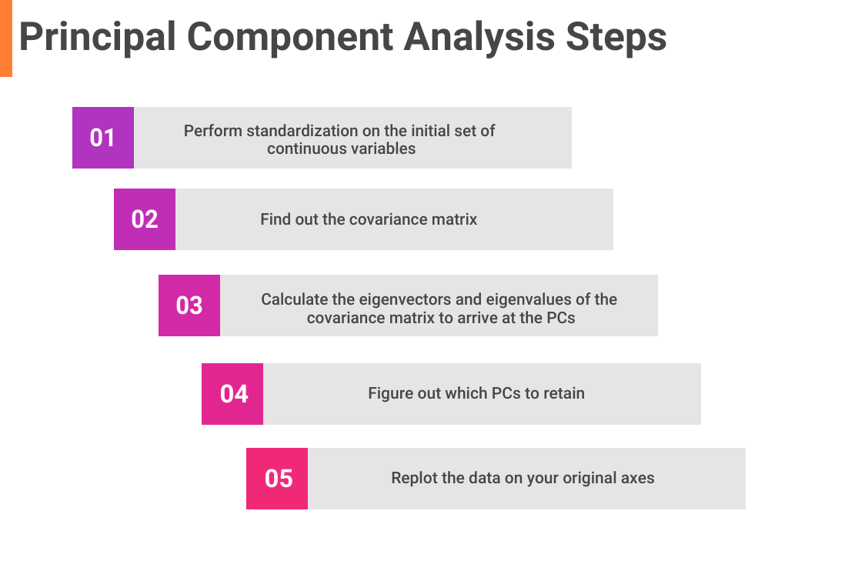
PCA Pansharpening
Background:
Dimensionality reduction: PCA compresses multiple spectral bands into fewer, more manageable components without losing important information.
Enhanced contrast: It improves the visibility of features across different bands, helping with tasks like classification and change detection.
Noise reduction: By separating relevant signals from noise, PCA reduces noise while enhancing image quality. Ex: Noise in SAR imagery
Notes:
How does PCA work?
Normalize the Data
Calculate the Covariance Matrix (CM)
Gives us information about how the features are related to each other
Break CM down into two separate components:
direction of maximum variance (Eigenvector)
Amount of variance in each Principal Component (Eigenvalue)
Transform our original data to align with these important directions (which are combinations of our original variables).

Slide 5
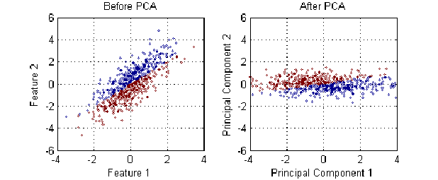
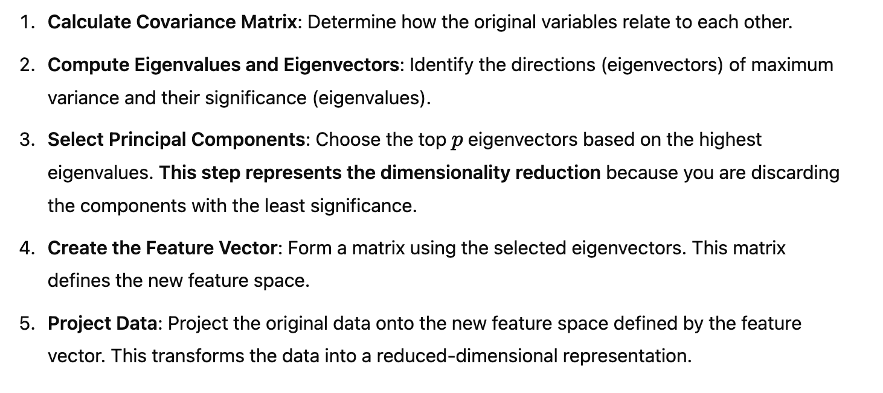
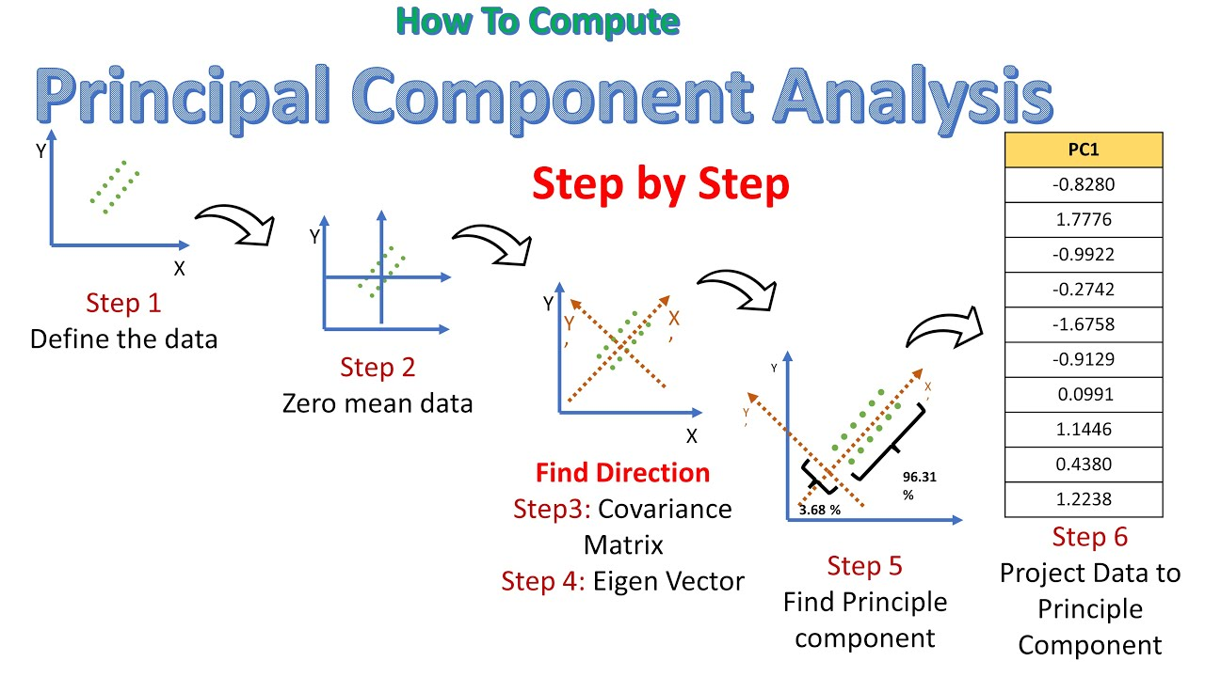
Helping Slide for PCA
Covariance is a measure of the relationship between two variables. Specifically, it indicates the degree to which two variables change together.

Slide 6
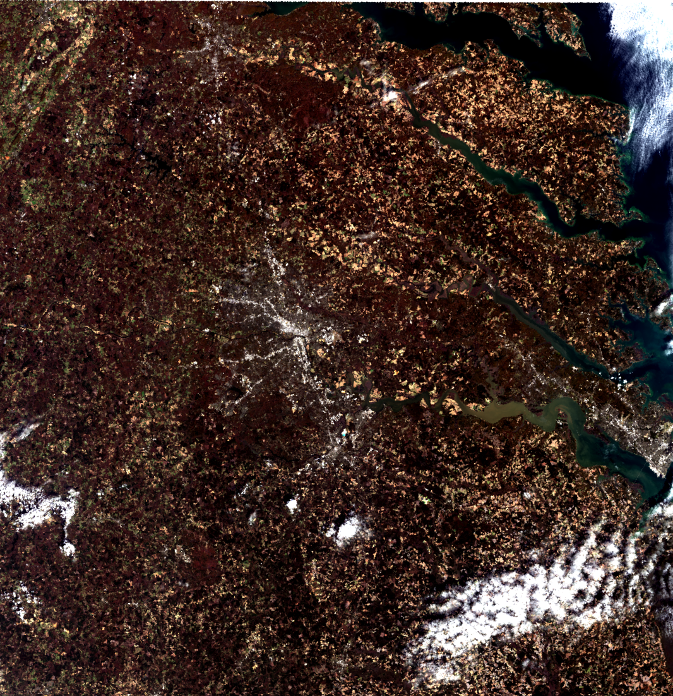
Methods
Landsat 9 Image
Location: Central Virginia
Source: USGS
Bands: 2 (B)
3 (G)
4 (R)
8 (Panchromatic)

Slide 7
Methods
Preprocessing
Converted DN to TOA reflectance and resampled to enhance spatial resolution.
Conversion to TOA Reflectance
Formula: TOA Reflectance
Purpose: To correct atmospheric effects and calibrate the image.
Resampling from 30m to 15m
Method: Bilinear interpolation, using the weighted average of the 4 nearest pixels.
Outcome: Improved spatial resolution for better analysis.
Output: GeoTIFF with preserved geotransform and projection.

Slide 8
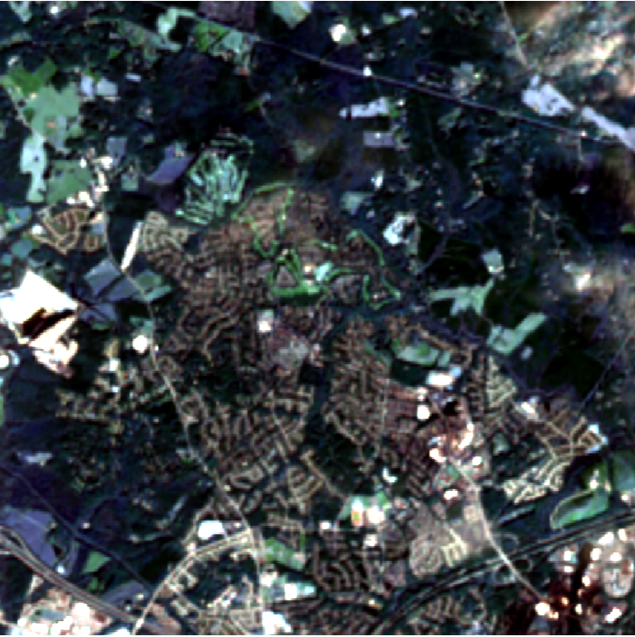
Methods
Created 500 x 500 pixel subset
Includes a combination of:
Forested land
Agricultural land
Suburban land
Urban land
Coordinates:
Subset selected from:
(6000, 6000) to (6500, 6500)

Slide 9
Methods - Brovey
Transformation Calculation
Calculated the sum of multispectral bands: sum_bands = B2 + B3 + B4.
Each band was scaled by the PAN intensity to create enhanced bands:
Red: Red_new = PAN * (Red / sum_bands)
Green: Green_new = PAN * (Green / sum_bands)
Blue: Blue_new = PAN * (Blue / sum_bands).
Output
Saved the enhanced RGB image as a GeoTIFF, preserving geotransform and projection metadata.

Slide 10
Methods PCA
PCA transformation
Loaded and Stacked multispectral bands (Blue, Green, Red) into a single 3D array for PCA analysis:
stacked_bands = np.dstack(band2, band3, band4)
reshaped_bands = stacked_bands.reshape(-1, 3) # 2D (pixel, bands)
Applied PCA (3 original bands, 3 PCs), pca_result represents PC array, PC1 has most variance
pca = PCA(n_components=3)
pca_result = pca.fit_transform(reshaped_bands)
Pansharpening
Replaced the first principal component with the high-resolution panchromatic band (Band 8):
pca_bands[:, :, 0] = band8
Performed inverse PCA to reconstruct the pansharpened image:
inverse_pca_result = pca.inverse_transform(pca_bands.reshape(-1, 3))
pansharpened_image = inverse_pca_result.reshape(band2.shape[0], band2.shape[1], 3)
Split pan-sharpened image into individual bands and write arrays

Slide 11
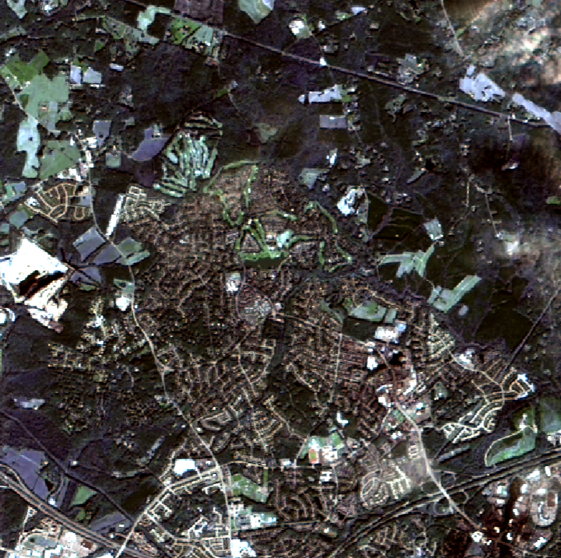
Original v Brovey
Original
Brovey

Slide 12
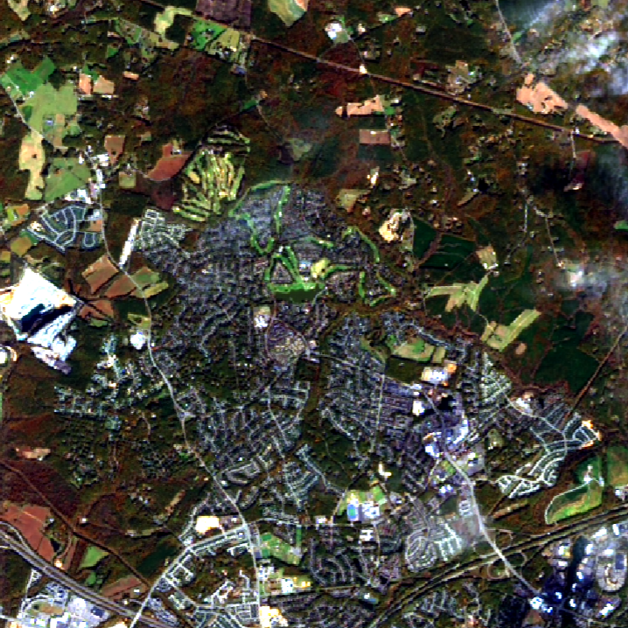
Original vs PCA
Original
PCA

Slide 13
Results
Brovey
PCA

Slide 14
Observations
Aspect | Brovey Transform | PCA Pansharpening
Color Contrast | Lower (closer to original image) | Higher
Spatial Detail | Equally effective | Equally effective
Complexity | Simpler, faster computation | More complex, computationally demanding

Slide 15
Questions

